Slide 1
English Writing II
Week 3 Organization of materials

Slide 2
Lesson plan
Skills in expository writing
Close-up reading – organizing different materials
Facts, data and opinions about COVID-19
In-class writing (40 minutes)

Slide 3
Different materials in factual writing
Making definitions
Explaining basic/ complex concepts or relationships
Describing a procedure or a process
Comparing and contrasting
Quoting from various sources
Reporting and explaining data/statistics
…

Slide 4
Expository writing (factual)
→ to define
→ to inform
→ to explain
→ to describe
→ to summarize
An encyclopedia entry
A how-to article on a website
A chapter in a textbook
An academic paper

Slide 5
Some writing prompts of exposition
(1) What were the direct and indirect causes of World War II?
(2) Explore how obesity affects a nation’s productivity & economy.
(3) What are the long-term effects of global warming, especially its estimated impact on coastal cities.
(4) What is your favorite retail business (e.g., Luckin)? Describe to a layman how this business was started, what products it sells, how it makes money, and what are its best qualities.

Slide 6

Brain-storming exercise:
What is a serious public health concern that you believe does not get enough attention? Describe this problem in detail. Back up your arguments with appropriate research.
BillGates_2015.mp4

Slide 7

Vocabulary
Preparedness, Global failure
Epidemiologist, R&D personnel
Global alert and response system
Health workers, medical corps, medics
Pathogen, vaccines, treatment, and diagnosis
Logistics and simulations
“Contagious” and “infectious”

Slide 8
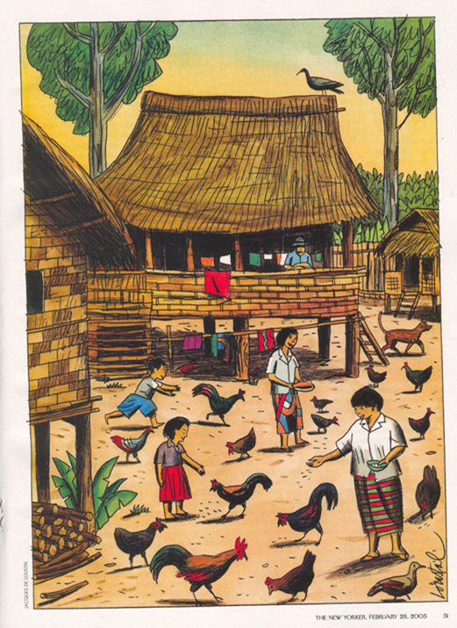
Close-up reading– Nature’s Bioterrorist
H5N1 human and animal cases in Thailand in 2004-2005
Nature's Bioterrorist (close-up).docx

Slide 9
Facts, Data and Opinions about COVID-19
The incubation period of coronavirus infection is generally 3-7 days and no longer than 14 days.
According to the Situation In Numbers released by WHO on February 29th local time, a total number of 85,403 cases had been confirmed globally, with 1,753 newly confirmed cases in the last 24 hours. ( Global Times)

Slide 10
Continued…
On February 29th, 2020, including ordinary masks, medical masks, and medical N95 masks, the daily production capacity of masks nationwide reached 110 million, and the daily output reached 116 million.(Development and Reform Commission)
“The director general of the WHO has recently spoken of a narrowing of the window of opportunity to control the current epidemic. The tipping point-after which our ability to prevent a global pandemic ends seems a lot closer after the past 24hours” said by Prof. Paul Hunter, professor of Health Protection, university of East Anglia, Feb.23, 2020

Slide 11
Continued…
This epidemic exposed the inadequacy of public medical supervision and the government should take some measures to change it.(By some political commentators)
The mortality rate was 1.4 percent, and only 1.9 percent of the patients reported direct contact with wildlife. Among nonresidents of Wuhan, 72.3 percent had contact with Wuhan people, including 31.3 percent who had visited the city, the study has found.(the New England Journal of Medicine, Feb. 28)

Slide 12
Continued…
“Coronavirus has totally changed the lifestyles of everyone. Though it has isolated people from each other, we however feel that people all over the country have been brought together more tightly. We should really appreciate our country for all these timely responses.” (My Mom)

Slide 13
Continued…
“In any crisis, leaders have two equally important responsibilities: solve the immediate problem and keep it from happening again. The COVID-19 pandemic is a case in point. We need to save lives now while also improving the way we respond to outbreaks in general. The first point is more pressing, but the second has crucial long-term consequences.” The New England Journal of Medicine，Bill Gates，Responding to COVID-19 – A Once-in-a-Century Pandemic?

Slide 14
Continued…
“The COVID-19 will basically be brought under control on the Chinese mainland by the end of April. That indicates people will be able to return to their normal work and companies resume normal operations and production.”— Zhong Nanshan (taken from China Daily)

Slide 15
In-class writing: A case report (40 min)
How was the first confirmed case (or other cases) of COVID-19 identified in your hometown? What about his/her experiences, symptoms, diagnosis, and treatments? What were the reaction & consequences?
→ Explaining terms and concepts
→ Quoting statistics, data, statements or opinions.
→ Describing events, procedures and relationships

Slide 16
Homework
Submission before MIDNIGHT today. (学在浙大)
Vocabulary – “contagious” vs. “infectious”
Reading – Close-analysis of other major events

